Slide 1

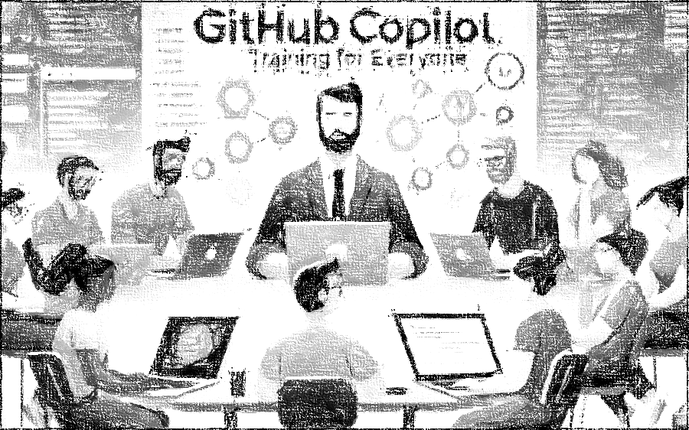


GitHub Copilot for Almost Everyone
Tim Warner
timw.info/linkedin
Notes:
How much flexibility am I allowed with these slide layouts? If you right-click a slide, you can play with layouts, but otherwise, not much flexibility.
Am I free to add my own graphics, providing MSFT attribution where necessary? When it comes to MS graphics, we're not allowed to use those, so please do not add in graphics unless they are created FROM SCRATCH by you.
Can I make the font a bit smaller? Some of the objectives are verbose and I don’t want to crowd the skills? Yes, I do this, too, when I review the slides because sometimes the default size just won't work.
Do the bullet points here need to be word-for-word from the outline or can I condense? We prefer word-for-word, but some of the sub-lesson titles are super long. Use your discretion, and we can address case-by-case during the review of each lesson's slides.

Slide 2

Tim Warner
Based in Nashville, TN, US
Central time zone
28-year Microsoft Certified Trainer (MCT)
6-year Microsoft MVP in Azure AI
Connect: TechTrainerTim.com

Slide 3
Learning Goals
Make a significant advancement in clearing the GitHub Copilot certification exam and earning the achievement badge
Tangibly improve your development work output by using GitHub Copilot and perhaps other generative AI-assisted solutions

Slide 4
Course materials
timw.info/copilotcert

Slide 5
Course Flow (Central Time Zone)
09:00 am - Start - Segment 1
10:00 am - 9-minute break - Segment 2
11:00 am - 9-minute break - Segment 3
12:00 pm - 9-minute break - Segment 4
01:00 pm - 9-minute break - Segment 5
02:00 pm - Finish

Slide 6
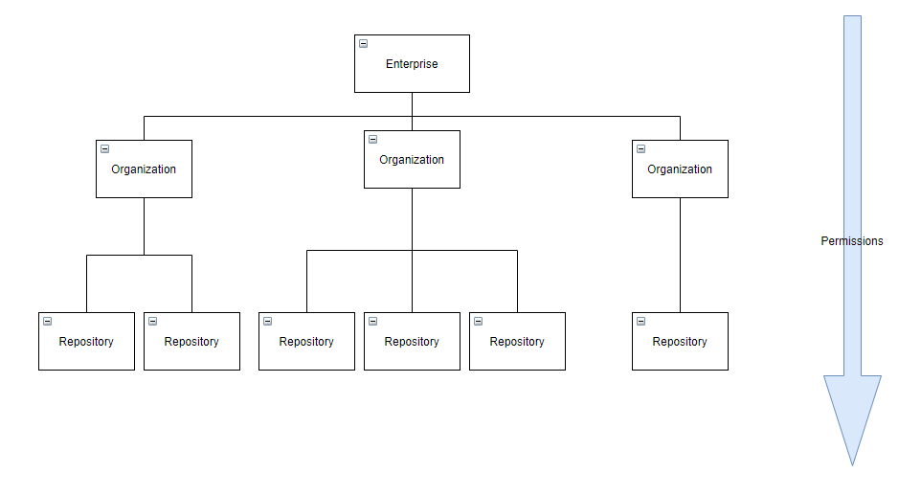
GitHub Enterprise Cloud (GHEC)
Reference: https://github.com/dduzgun-security/github-enterprise-cloud-configuration

Slide 7

Thank you!
Materials: timw.info/copilotaio
Contact: timw.info/linkedin

Slide 8
This Section Is...

Slide 9
Artificial Intelligence (AI)
The field of computer science dedicated to creating machines that can perform tasks requiring human-like intelligence, such as problem-solving, learning, and understanding natural language. Think of learned pattern recognition in humans over time.

Slide 10
Machine Learning (ML)
A subset of Artificial Intelligence that focuses on developing algorithms and statistical models to enable computers to learn from and make predictions or decisions based on data without explicit programming.

Slide 11
Neural Networks
Computational models inspired by the human brain, consisting of interconnected nodes or neurons, which are organized in layers and designed to recognize patterns and process complex data by adjusting the connections between nodes through a learning process.

Slide 12

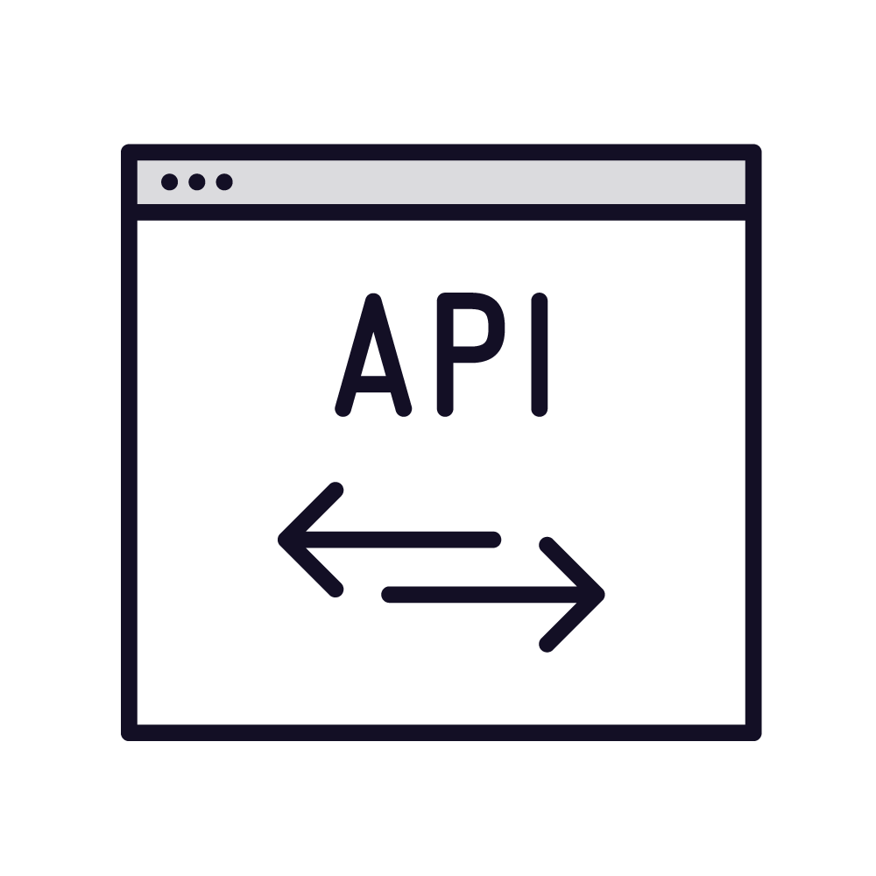

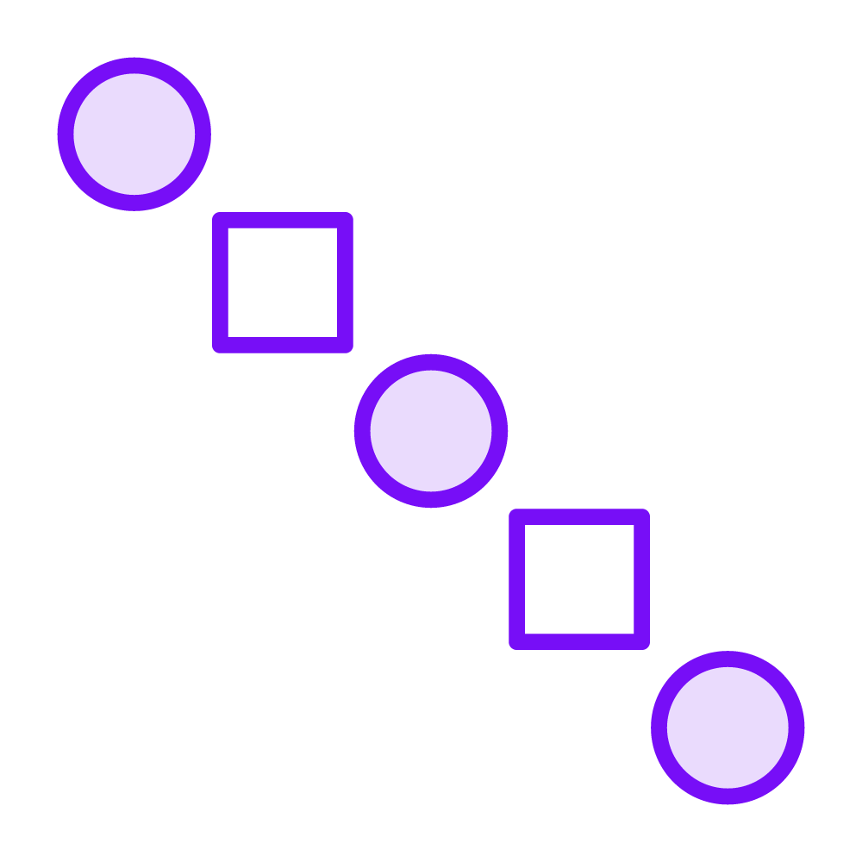
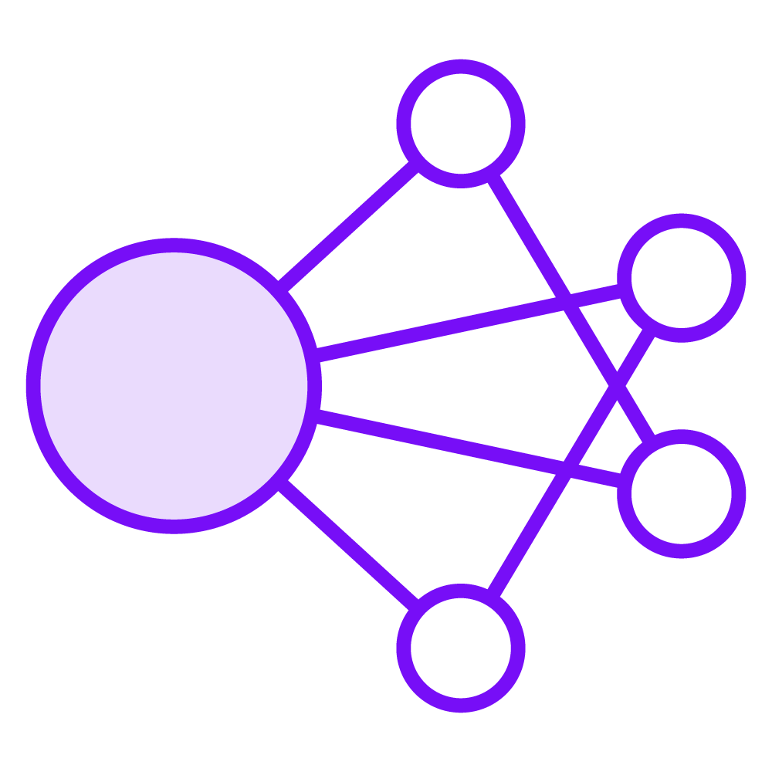



Machine Learning (ML) & Inference
New data
REST API
Prediction
Pattern identification
Algorithm
Training data
Test data
Big compute
Algorithm

Slide 13
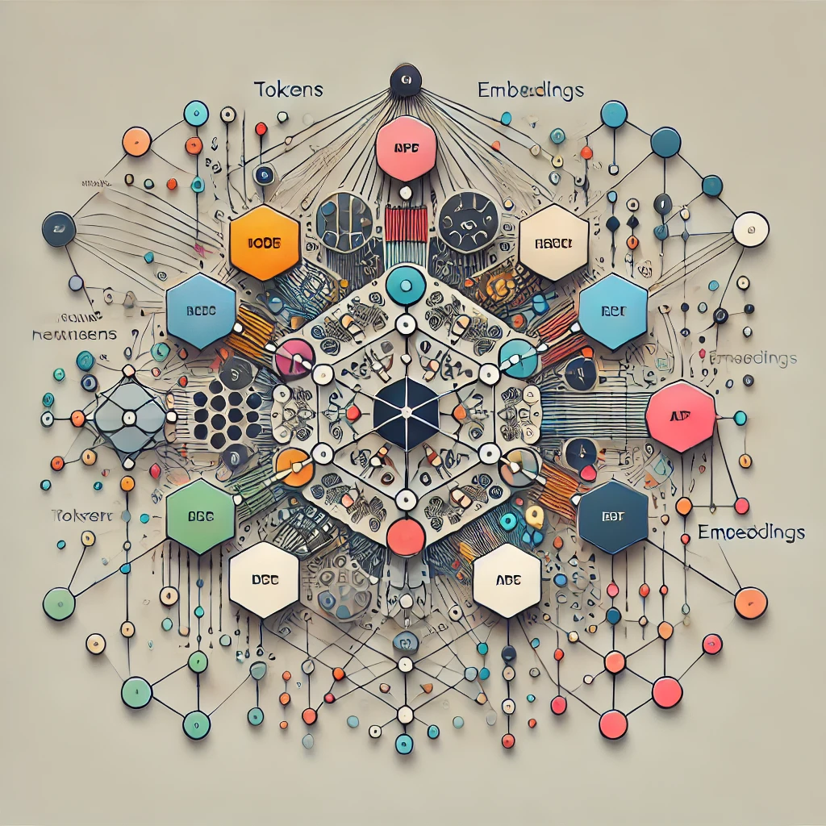
Neural Network

Slide 14

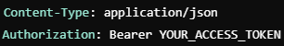
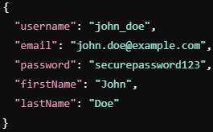


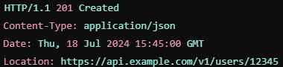
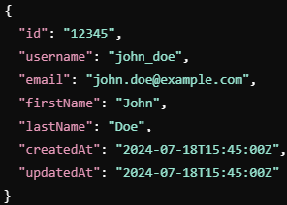
REST API example: Create a user
POST https://api.example.com/v1/users
Rate
limiting
Request headers
Request body
Client
HTTP 200 (OK)
API server
Response headers
Response body

Slide 15
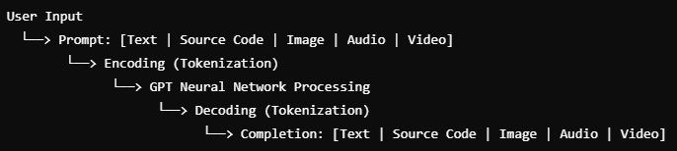
Multimodal Generative AI

Slide 16
Pro tip: Use a prompt.txt file
Store your system prompts
Store and share other useful prompts
...or add to .gitignore to hide

Slide 17
Pro Tip: Tell GH Copilot about you
Reduce the assumptions GitHub Copilot makes when creating completions for you

Slide 18
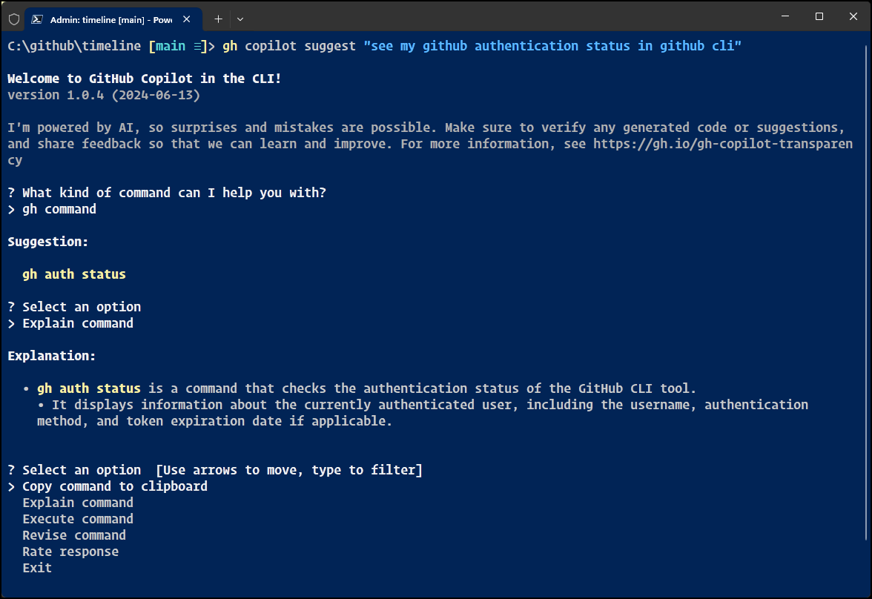
Pro Tip: Use GH Copilot in the CLI

Slide 19
Foundational Terminology

Slide 20




New Paradigms...and Fear
1970s
Calculators
1980s
Robotics
1990s
WWW
2010s
AI

Slide 21
Preliminary Terminology
OpenAI is a research organization that aims to create safe and beneficial AI for humanity
ChatGPT is a large language model (LLM) that understands and generates natural language text

Slide 22
Preliminary Terminology
GitHub Copilot is an AI-powered pair programmer that suggests code snippets based on the context of your code
Azure OpenAI is a cloud-based platform that offers access to OpenAI's cutting-edge language models and AI capabilities

Slide 23
Lesson 1: Introduction to OpenAI and its Models
1.1 Overview of OpenAI

Slide 24
OpenAI
OpenAI is an AI research lab founded in December 2015, comprising both for-profit and non-profit entities
openai.com
The mission of OpenAI is to ensure that artificial general intelligence (AGI) benefits all humanity
OpenAI uses a variety of ML techniques to train AI models
Notes:
1. Do I use title or sentence case for slide titles? We default to title case.

Slide 25
OpenAI and AGI
AGI: Artificial General Intelligence
A type of AI that is as capable as a human at performing any intellectual task
OpenAI and Microsoft are committed to Responsible AI, the practices involving the creation, deployment, and use of AI in a manner that is ethically sound, transparent, accountable, and beneficial for all stakeholders
Notes:
1. Do I use title or sentence case for slide titles? We default to title case.

Slide 26
Microsoft and OpenAI
Multi-billion dollar investment between 2019 and today
Microsoft uses OpenAI's models to power its cloud services and products
GitHub Copilot
Azure OpenAI service

Slide 27
Lesson 2: Brush Up on Git and GitHub Basics
2.1 Get a brief introduction to Git
2.2 Get to know GitHub
2.3 Master basic Git commands and workflow
2.4 Sign up for GitHub Copilot
Notes:
How much flexibility am I allowed with these slide layouts? If you right-click a slide, you can play with layouts, but otherwise, not much flexibility.
Am I free to add my own graphics, providing MSFT attribution where necessary? When it comes to MS graphics, we're not allowed to use those, so please do not add in graphics unless they are created FROM SCRATCH by you.
Can I make the font a bit smaller? Some of the objectives are verbose and I don’t want to crowd the skills? Yes, I do this, too, when I review the slides because sometimes the default size just won't work.
Do the bullet points here need to be word-for-word from the outline or can I condense? We prefer word-for-word, but some of the sub-lesson titles are super long. Use your discretion, and we can address case-by-case during the review of each lesson's slides.

Slide 28
Lesson 2: Brush Up on Git and GitHub Basics
2.1 Get a brief introduction to Git

Slide 29
Why Should I Care?
Git's wide acceptance in the software development industry makes it an essential skill
Yes, even for IT Operations professionals
GitHub Copilot is embedded with your Integrated Development Environment (IDE), which in turn integrates with Git
Copilot can help you with those arcane Git commands
Copilot stretches fully across the GitHub ecosystem

Slide 30
Git
Git is a free, open-source, cross-platform distributed version control system that allows multiple people to work on a project at the same time without overwriting each other's changes
Git offers full change history and rollback
Git was created by Linus Torvalds in 2005 to manage the Linux kernel's source code

Slide 31
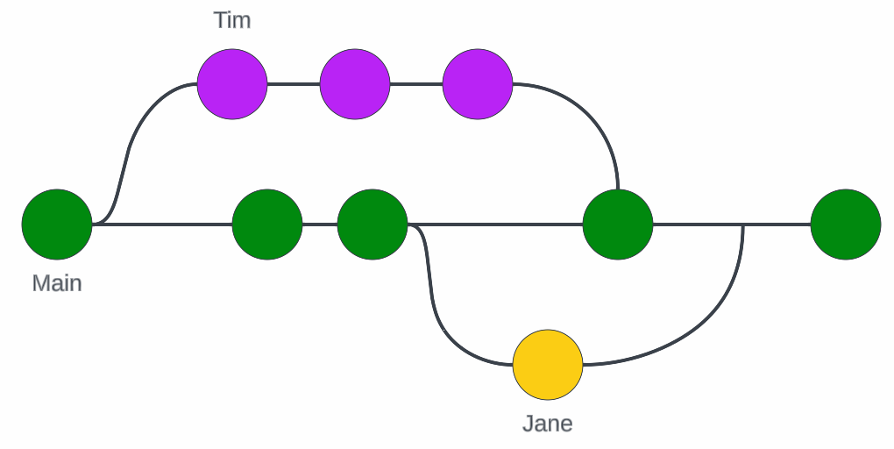
Git Branching

Slide 32
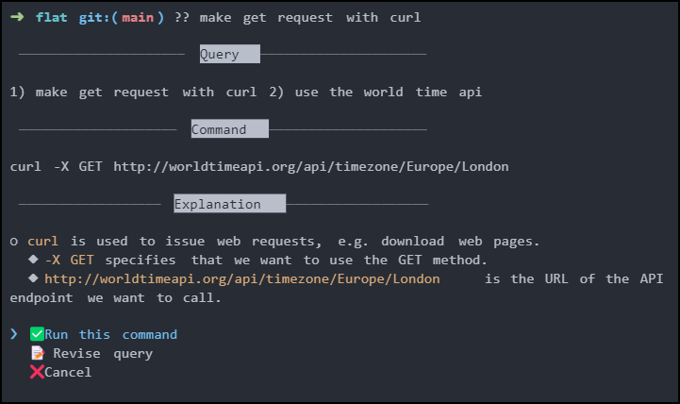
Copilot for CLI
GitHub Next
??
git?
gh?

Slide 33
Lesson 2: Brush Up on Git and GitHub Basics
2.2 Get to know GitHub

Slide 34
GitHub
Web-based hosting service for Git repositories, providing a graphical interface and additional features like bug tracking and task management.
Launched in 2008, it has become one of the world's largest platforms for collaborative software development.
Hosts code for both private projects and free public open-source projects.
GitHub integrates with common platforms and tools, such as IDEs, Slack, Jira, etc.

Slide 35
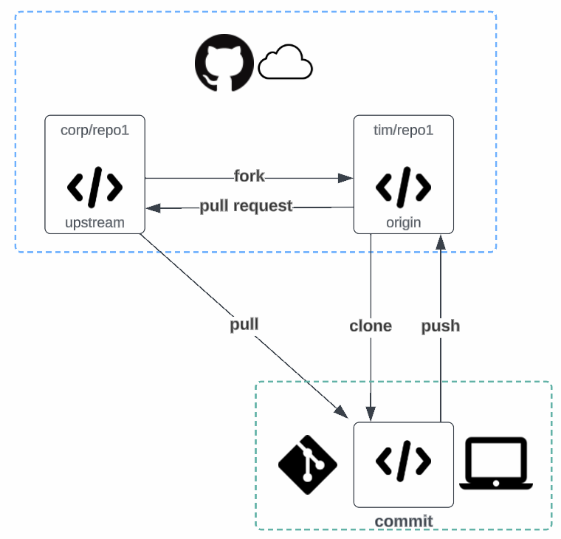
GitHub Flow

Slide 36
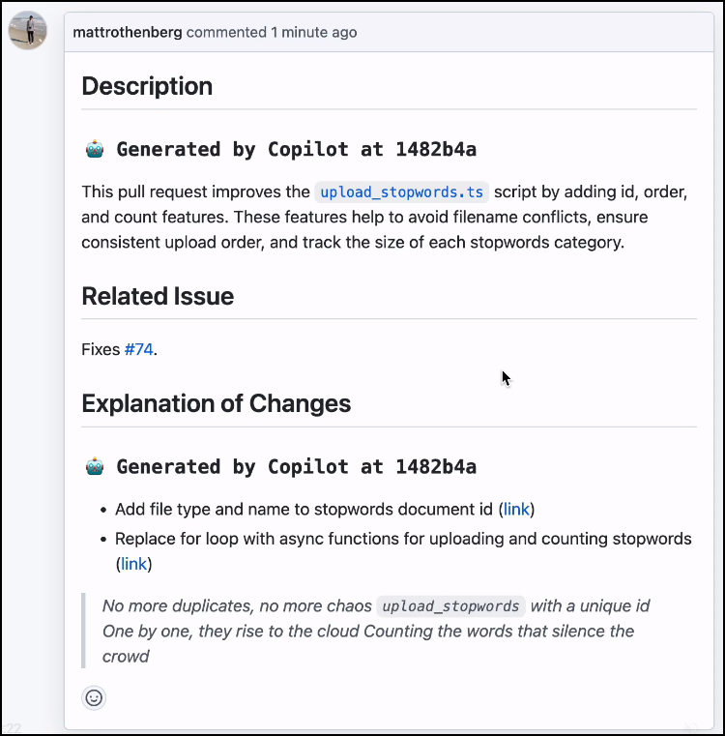
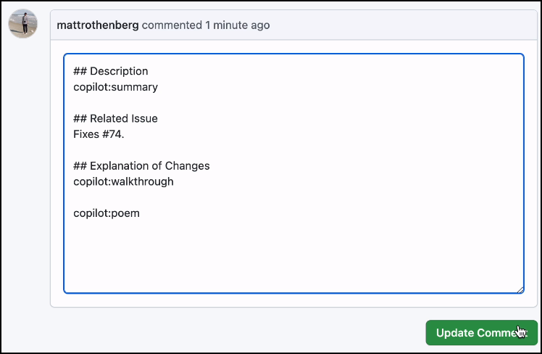
Copilot for Pull Requests

Slide 37
Lesson 2: Brush Up on Git and GitHub Basics
2.3 Master basic Git commands and workflow

Slide 38
Essential Git Commands
git init: Initialize a Git repository
git checkout: Switch branches
git status: Show status changes
git add: Stage changes for commit
git commit: Record a SHA hash for the changes
git remote: Connect to remote repositories
git push: Uploads changeset to remote
git log: Displays commit history

Slide 39
Lesson 3: Understand GitHub Copilot
3.1 Get familiar with GitHub Copilot
3.2 Unpack how GitHub Copilot works
3.3 Highlight key features and benefits of GitHub Copilot
Notes:
How much flexibility am I allowed with these slide layouts? If you right-click a slide, you can play with layouts, but otherwise, not much flexibility.
Am I free to add my own graphics, providing MSFT attribution where necessary? When it comes to MS graphics, we're not allowed to use those, so please do not add in graphics unless they are created FROM SCRATCH by you.
Can I make the font a bit smaller? Some of the objectives are verbose and I don’t want to crowd the skills? Yes, I do this, too, when I review the slides because sometimes the default size just won't work.
Do the bullet points here need to be word-for-word from the outline or can I condense? We prefer word-for-word, but some of the sub-lesson titles are super long. Use your discretion, and we can address case-by-case during the review of each lesson's slides.

Slide 40
Lesson 3: Understand GitHub Copilot
3.1 Get familiar with GitHub Copilot

Slide 41
GitHub Copilot
"AI-powered pair programmer"
AI-powered code assistant developed by GitHub and OpenAI
Copilot suggests whole lines or blocks of code as developers type, helping them write code faster and learn new languages or libraries more quickly
Powered by GPT 3.5 Turbo or GPT-4 (formerly Codex) via GitHub open-source repos

Slide 42
Lesson 3: Understand GitHub Copilot
3.2 Unpack how GitHub Copilot works

Slide 43
GitHub Copilot Under the Hood
GitHub Copilot uses machine learning to suggest code as you type based on the context of your current work, including comments and code in the same workspace
Copilot does not just replicate code snippets it was trained on, but generates new suggestions by understanding the intent behind the code

Slide 44
GitHub Copilot Language Support
Provides suggestions for numerous languages and frameworks
Works especially well for:
Python
JavaScript / TypeScript
Ruby
Go
C++ / C#

Slide 45
GitHub Copilot Supported IDEs
Visual Studio
Visual Studio Code
JetBrains IDEs
Neovim

Slide 46
Lesson 4: Integrate GitHub Copilot with Your IDE
4.1 Connect GitHub Copilot to Visual Studio
4.2 Set up GitHub Copilot with Visual Studio Code
4.3 Integrate GitHub Copilot with JetBrains IDE
4.4 Add GitHub Copilot to Neovim
Notes:
How much flexibility am I allowed with these slide layouts? If you right-click a slide, you can play with layouts, but otherwise, not much flexibility.
Am I free to add my own graphics, providing MSFT attribution where necessary? When it comes to MS graphics, we're not allowed to use those, so please do not add in graphics unless they are created FROM SCRATCH by you.
Can I make the font a bit smaller? Some of the objectives are verbose and I don’t want to crowd the skills? Yes, I do this, too, when I review the slides because sometimes the default size just won't work.
Do the bullet points here need to be word-for-word from the outline or can I condense? We prefer word-for-word, but some of the sub-lesson titles are super long. Use your discretion, and we can address case-by-case during the review of each lesson's slides.

Slide 47
Lesson 4: Integrate GitHub Copilot with Your IDE
4.1 Connect GitHub Copilot to Visual Studio

Slide 48
The General Setup Process
Get GitHub.com account
Start GitHub Copilot trial
Install GitHub Copilot IDE extension or plugin
Profit!

Slide 49
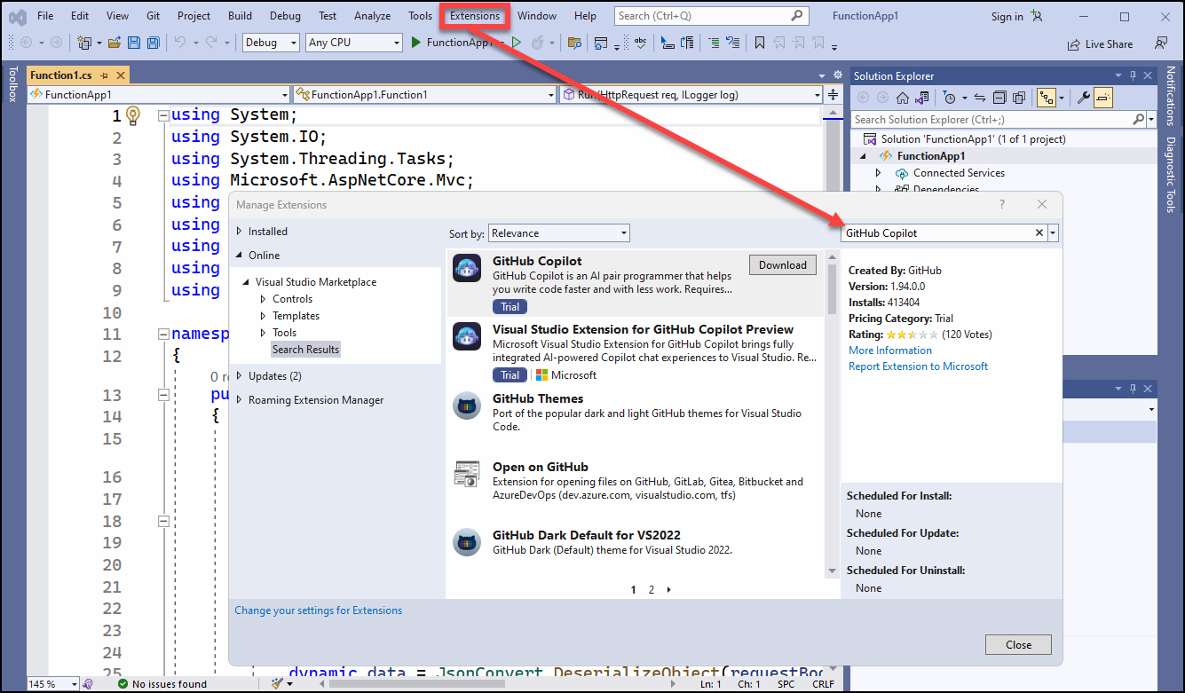
Visual Studio

Slide 50
Lesson 4: Integrate GitHub Copilot with Your IDE
4.2 Set up GitHub Copilot in Visual Studio Code

Slide 51
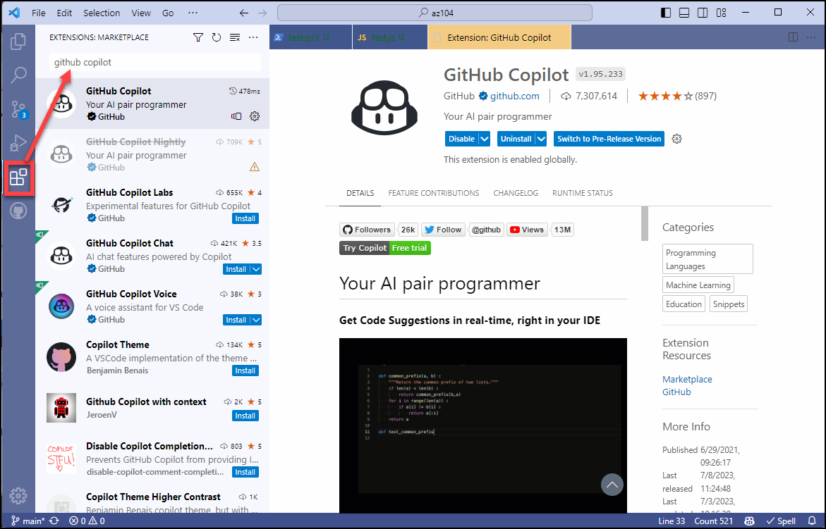
Visual Studio Code

Slide 52
Lesson 4: Integrate GitHub Copilot with Your IDE
4.3 Integrate GitHub Copilot into JetBrains IDE

Slide 53
Supported JetBrains IDEs
IntelliJ IDEA (Ultimate, Community, Educational)
Android Studio
AppCode
CLion
Code With Me Guest
DataGrip
DataSpell
GoLand
JetBrains Client
MPS
PhpStorm
PyCharm (Professional, Community, Educational)
Rider
RubyMine
WebStorm

Slide 54
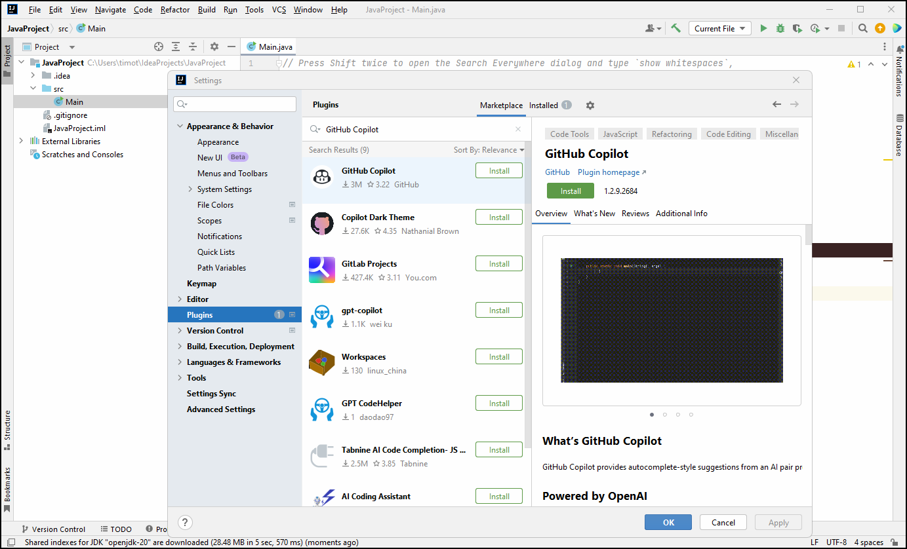
JetBrains IntelliJ IDEA

Slide 55
Lesson 5: Apply GitHub Copilot in Coding
5.1 Generate functions with GitHub Copilot
5.2 Use GitHub Copilot to generate classes
Notes:
How much flexibility am I allowed with these slide layouts? If you right-click a slide, you can play with layouts, but otherwise, not much flexibility.
Am I free to add my own graphics, providing MSFT attribution where necessary? When it comes to MS graphics, we're not allowed to use those, so please do not add in graphics unless they are created FROM SCRATCH by you.
Can I make the font a bit smaller? Some of the objectives are verbose and I don’t want to crowd the skills? Yes, I do this, too, when I review the slides because sometimes the default size just won't work.
Do the bullet points here need to be word-for-word from the outline or can I condense? We prefer word-for-word, but some of the sub-lesson titles are super long. Use your discretion, and we can address case-by-case during the review of each lesson's slides.

Slide 56
Lesson 5: Apply GitHub Copilot in Coding
5.1 Generate functions with GitHub Copilot

Slide 57
What is a Function?
A function in programming is a reusable piece of code that performs a specific task or operation, often taking inputs and returning an output

Slide 58
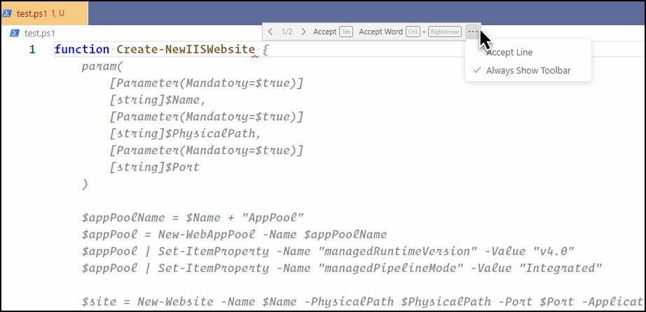
Create a Function with Copilot
Start typing and pause (prompt)
Next suggestion: ALT+] Previous suggestion: ALT+[
Reject suggestion: ESC

Slide 59
Lesson 5: Apply GitHub Copilot in Coding
5.2 Use GitHub Copilot to generate classes

Slide 60
What is a Class?
A class in programming is a blueprint or template for creating objects, encapsulating related data and behavior, and defining methods and variables that constitute an object's properties and actions

Slide 61
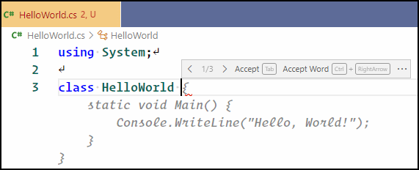
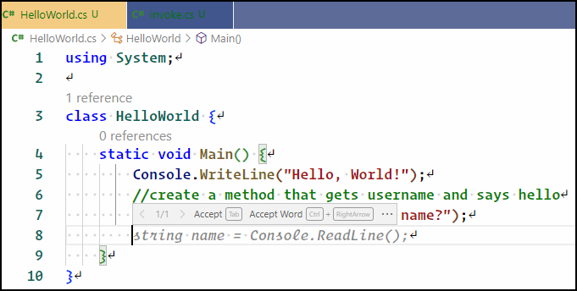
Create a Class with Copilot

Slide 62
Tips and Tricks
Know what your code should look like
Helps you choose the best suggestion
Write meaningful function, class, and token names
More context matters to the AI
Remember the GIGO rule
Never blindly copy code snippets
Give GitHub Copilot an example

Slide 63
Demo Tasks
Make a function
Debug using ChatGPT
Custom instructions
Sensitivity issue
Notes:
1. Do I use title or sentence case for slide titles? We default to title case.

Slide 64
Lesson 6: Enhance Coding with GitHub Copilot's Comment-Based Generation
6.1 Understand prompt engineering basics
6.2 Explore comment-based code generation
6.3 Build applications with comment-based code generation
Notes:
How much flexibility am I allowed with these slide layouts? If you right-click a slide, you can play with layouts, but otherwise, not much flexibility.
Am I free to add my own graphics, providing MSFT attribution where necessary? When it comes to MS graphics, we're not allowed to use those, so please do not add in graphics unless they are created FROM SCRATCH by you.
Can I make the font a bit smaller? Some of the objectives are verbose and I don’t want to crowd the skills? Yes, I do this, too, when I review the slides because sometimes the default size just won't work.
Do the bullet points here need to be word-for-word from the outline or can I condense? We prefer word-for-word, but some of the sub-lesson titles are super long. Use your discretion, and we can address case-by-case during the review of each lesson's slides.

Slide 65
Lesson 6: Enhance Coding with GitHub Copilot's Comment-Based Generation
6.1 Understand prompt engineering basics

Slide 66
Prompt Engineering
Prompt engineering is the practice of designing and refining inputs (prompts) for language models in order to elicit desired outputs, effectively guiding the model's response to achieve specific results or behaviors

Slide 67
Prompt Engineering Tips
Start with high-level context followed by more detailed instructions
Provide examples
Open relevant files in separate editor tabs
Copilot's scope of context is the code editor
Give the AI an identity (role-play teacher and student)
Iterate your prompts

Slide 68
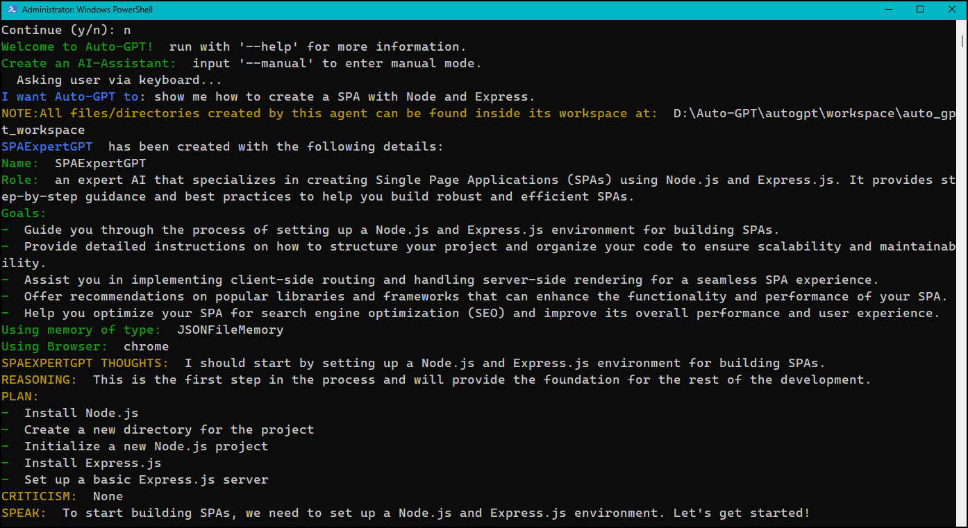
Auto GPT
github.com/Significant-Gravitas/Auto-GP

Slide 69
Lesson 6: Enhance Coding with GitHub Copilot's Comment-Based Generation
6.2 Explore comment-based code generation

Slide 70
Comment-Based Suggestions
First order of business is learn how to write comments in your chosen language!
Line comments
Multi-line comments
Second is to ensure VS Code understands your language
Relevant runtimes, libraries, SDKs
VS Code language extension(s)

Slide 71
GitHub Copilot Chat
Chat interface for GitHub Copilot
Part of GitHub Copilot X
GPT-4 model
Most important use cases:
Generating unit test cases
Explaining code
Proposing code fixes
Answering coding questions

Slide 72
Lesson 7: Leverage Unit Testing with GitHub Copilot
7.1 The importance of test-driven development
7.2 Create unit tests with GitHub Copilot
Notes:
How much flexibility am I allowed with these slide layouts? If you right-click a slide, you can play with layouts, but otherwise, not much flexibility.
Am I free to add my own graphics, providing MSFT attribution where necessary? When it comes to MS graphics, we're not allowed to use those, so please do not add in graphics unless they are created FROM SCRATCH by you.
Can I make the font a bit smaller? Some of the objectives are verbose and I don’t want to crowd the skills? Yes, I do this, too, when I review the slides because sometimes the default size just won't work.
Do the bullet points here need to be word-for-word from the outline or can I condense? We prefer word-for-word, but some of the sub-lesson titles are super long. Use your discretion, and we can address case-by-case during the review of each lesson's slides.

Slide 73
Lesson 7: Leverage Unit Testing with GitHub Copilot
7.1 The importance of test-driven development

Slide 74
Test-Driven Development (TDD)
Software development practices designed to improve code quality and facilitate easier maintenance
Regression testing: Make sure new changes don't break existing functionality
Unit tests focus on testing the smallest piece of code that can be isolated in a system, usually a method or a function within a class

Slide 75
Lesson 8: Capstone: Build and Deploy an App with GitHub Copilot
8.1 Design, build, and test the application
8.2 Deploy the application to Microsoft Azure
Notes:
How much flexibility am I allowed with these slide layouts? If you right-click a slide, you can play with layouts, but otherwise, not much flexibility.
Am I free to add my own graphics, providing MSFT attribution where necessary? When it comes to MS graphics, we're not allowed to use those, so please do not add in graphics unless they are created FROM SCRATCH by you.
Can I make the font a bit smaller? Some of the objectives are verbose and I don’t want to crowd the skills? Yes, I do this, too, when I review the slides because sometimes the default size just won't work.
Do the bullet points here need to be word-for-word from the outline or can I condense? We prefer word-for-word, but some of the sub-lesson titles are super long. Use your discretion, and we can address case-by-case during the review of each lesson's slides.

Slide 76
Lesson 8: Capstone: Build and Deploy an App with GitHub Copilot
8.1 Design, build, and test the application

Slide 77
Solution requirements
3-page, simple POC Node.js web application
Unit tests to verify the page routing
Simple To Do app that uses file-based data storage
Concerns and workarounds:
September 2021 knowledge cut-off
Sometimes GitHub Copilot Chat gives current information
ChatGPT has a plugin architecture that supports web search

Slide 78
Lesson 8: Capstone: Build and Deploy an App with GitHub Copilot
8.2 Deploy the application to Microsoft Azure

Slide 79
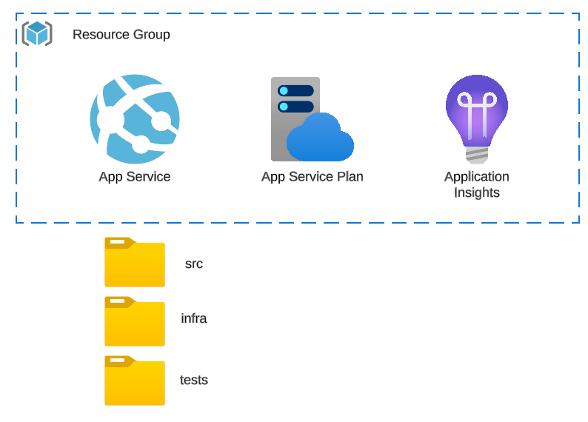
Proposed architecture

Slide 80
Demo Tasks
Notes:
1. Do I use title or sentence case for slide titles? We default to title case.

Slide 81
Lesson 7: Leverage Unit Testing with GitHub Copilot
7.2 Create unit tests with GitHub Copilot

Slide 82
Unit Tests with GitHub Copilot
With GitHub Copilot Chat:
Select function
Prompt /tests
Done!
Remember to keep your code and test files open in VS Code

Slide 83
Demo Tasks

Slide 84
Lesson 6: Enhance Coding with GitHub Copilot's Comment-Based Generation
6.3 Build applications with comment-based code generation

Slide 85
Demo Tasks
Build app using comments
Publish to GitHub
Use Copilot for PRs
Use Copilot for Docs

Slide 86
Lesson 4: Integrate GitHub Copilot with Your IDE
4.4 Add GitHub Copilot to Neovim

Slide 87
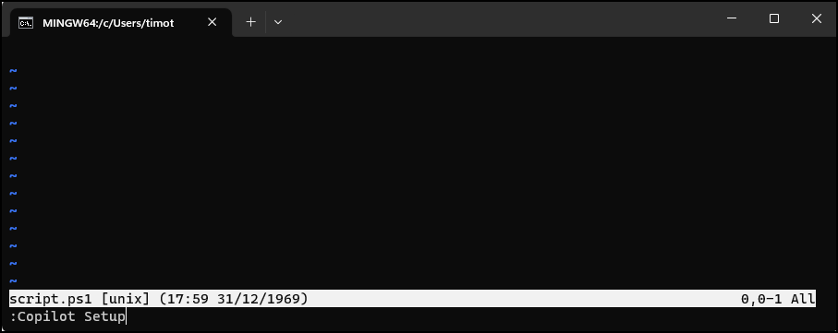
Vim/Neovim

Slide 88
Demo Tasks
Set up IDEs
Test them
Notes:
1. Do I use title or sentence case for slide titles? We default to title case.

Slide 89
Lesson 3: Understand GitHub Copilot
3.3 Highlight key features and benefits of GitHub Copilot

Slide 90
GitHub Copilot Key Benefits
Contextual code suggestions
Improved productivity
Multi-language support
Pair programming experience
Function autocompletion
Reduced errors
Improved coding efficiency
Great way to learn a new programming language or framework

Slide 91
GitHub Copilot - Considerations
GitHub Copilot's suggestions are not always perfect
It's important to review the code for accuracy
Developers should be aware of potential issues around code licensing and copyright when using AI-generated code

Slide 92
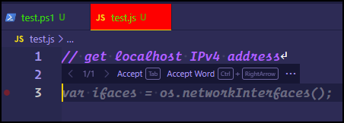


GitHub Copilot Terminology
Suggestions toolbar
Prompt
Suggestion
GitHub Copilot status icon
CTRL+ENTER opens Completions panel

Slide 93
GitHub Copilot X
Powered by the GitHub Next development team
Copilot Chat
Copilot Docs
Copilot for PRs
Copilot for CLI

Slide 94
Demo Tasks
Show off GitHub Copilot features in VS Code
Pay attention to key terminology

Slide 95
Lesson 2: Brush Up on Git and GitHub Basics
2.4 Sign up for GitHub Copilot

Slide 96
Sign Up for GitHub Copilot
Available for GitHub Personal and Business accounts
One-time 30-day trial
Automatically converts to paid subscription
Copilot for Individuals SaaS pricing model
$10 USD per calendar month
$100 per year
Free subscription to verified students, teachers, and popular open-source repo maintainers

Slide 97
Demo Tasks
Install Git
Install and set up Visual Studio Code
GitHub Copilot X / GitHubNext
Sign up for GitHub Copilot
Tweak settings

Slide 98
Lesson 1: Introduction to OpenAI and its Models
1.2 Explore the range of OpenAI models

Slide 99
Artificial Intelligence (AI)
The field of computer science dedicated to creating machines that can perform tasks requiring human-like intelligence, such as problem-solving, learning, and understanding natural language.

Slide 100
Generative AI
A subset of artificial intelligence that focuses on creating new data models, such as images, sounds, or text, that can mimic or recreate human-like patterns based on the input it has been trained on.

Slide 101
Machine Learning (ML)
A subset of artificial intelligence that focuses on developing algorithms and statistical models to enable computers to learn from and make predictions or decisions based on data without explicit programming
Components
Engineered source data
Statistical algorithms
Parallel compute
REST API endpoints for prediction or classification

Slide 102
GPT
Generative Pre-Trained Transformer
Large Language Model (LLM)
Generate human-like text based on text prompts
GPT was originally released in 2018
Translation, summarization, question-answering, code generation

Slide 103
ChatGPT
Specialized version of GPT
Fine-tuned for human-like conversations
Context awareness
Engaging and interactive responses

Slide 104
Microsoft Bing
Integrated into the Microsoft Edge browser
Powered by GPT-4
Adheres strictly to Microsoft Responsible AI principles
Provides references to all completions

Slide 105
GitHub Copilot
GPT-based model specializing on source code generation
Trained in part with GitHub open-source repos
Python is strongest (but not only) language
Code debugging/refactoring
Unit testing

Slide 106
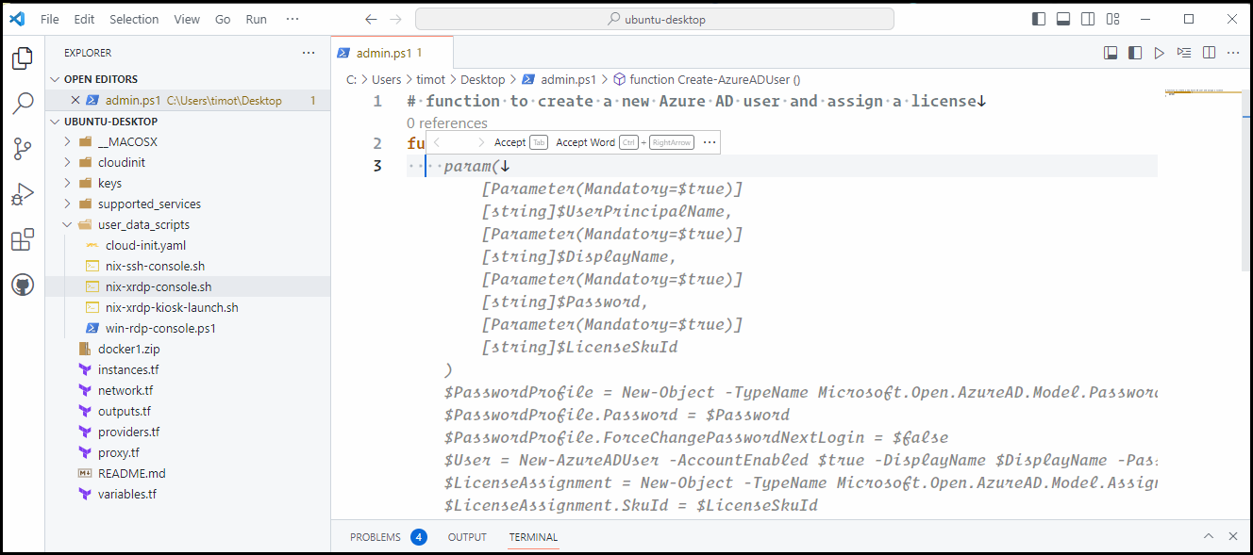
GitHub Copilot

Slide 107
DALL-E
Portmanteau of Dali and WALL-E
Sibling model to Codex
Image generation from text
Credit-based pricing
115 generations for $15 USD

Slide 108
Azure OpenAI Service
Microsoft Azure-based product that offers REST API access to OpenAI's models
Python SDK
Azure OpenAI Studio web console
Secure access with Private Link service
Fine-tune the models using your internal corporate data

Slide 109
Demo Tasks
New Bing
ChatGPT
DALL-E
Azure OpenAI service
OpenAI Playground

